Slide 1
ACADEMY
SABI
Bridging education inequality gap in Nigerian public primary schools.

Slide 2
VISION
To utilize technology as a resource tool in providing quality education to children living in low-income communities.
SABI
ACADEMY

Slide 3
MASSIVE MARKET
10.5 million children of primary age are out of school.
25% of current pupils drop out of primary schools in Nigeria.
60% of primary 6 pupils cannot read at all.
SOURCE: Ministry of Education, UNESCO, Nigerian Bureau of Statistics (NBS).
SABI
ACADEMY

Slide 4
OUR INDUSTRY: Education sector
Nwakwukwo
WhizApp
SABI
ACADEMY

Slide 5
CURRENT PAIN
Lack of tailored learning content.
Dearth of 21st century skills in children in low-income primary schools.
Sabi Academy exists to serve as a channel to deliver personalized learning content to children in low-income communities.
SABI
ACADEMY

Slide 6
OUR PRODUCT
A unique learning education platform that utilizes Nigeria’s three major ethnic languages in teaching learning content and facilitating 21st century skills learning.
SABI
ACADEMY

Slide 7
BUSINESS MODEL CANVAS
KEY PARTNERS
KEY ACTIVITIES
VALUE PROPOSITIONS
CUSTOMER RELATIONSHIPS
Social enterprises.
Private Organizations.
Government.
NGOs.
School to school demo.
Community awareness.
Collaboration with TFN fellows.
Feedback survey.
Access to quality education delivery.
Facilitating learning of 21st century skills.
Delivering learning content in local languages.
Establishing relationships with teachers in low-income communities.
Strategic partnership with the state universal board of education.
KEY RESOURCES
Human resources.
Funding.
Facilities.
Materials.
CUSTOMER SEGMENTS
REVENUE STREAMS
CHANNELS
Primary school age children in low income communities.
Children enrolled in underserved primary schools.
Grants.
Donations.
Government and private partnerships.
Schools.
Communities.
COST STRUCTURE
Funding.
Human resources.
SABI
ACADEMY

Slide 8
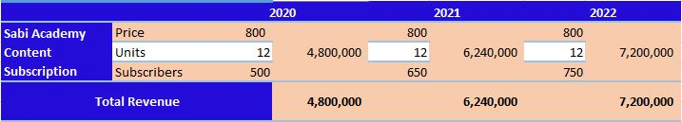
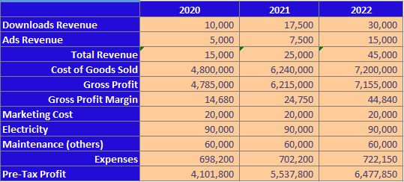
PROJECTED REVENUE
PROJECTED INCOME STATEMENT
SABI
ACADEMY

Slide 9
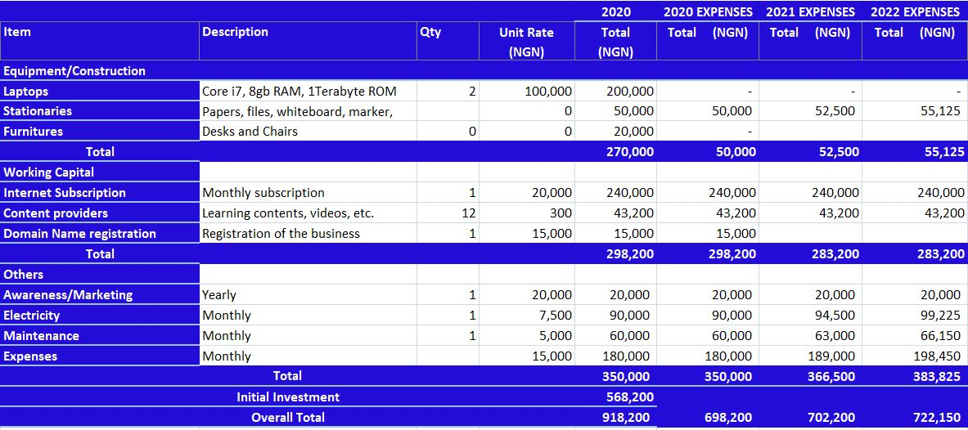
PROJECTED INITIAL INVESTMENT
SABI
ACADEMY

Slide 10
SUMMARY
“ Education is a powerful tool to change the world” - NELSON MANDELA
Sabi Academy uniquely connects primary school age children in low-income communities to personalized learning content aimed at facilitating learning of 21st century skills which includes critical thinking, creativity, communication and problem-solving skills. This is achieved by leveraging technology and translating all learning content into Nigeria’s three major indigenous languages.
SABI
ACADEMY

